Slide 1
Neural Network Approach
for Camera-Based Indoor Positioning
Martina Kuchtová
supervisor: RNDr. Miroslav Opiela, PhD.
consultant: RNDr. Šimon Horvát, PhD.
30.11.2023, Preddiplomový seminár

Slide 2
Aims
1.
2.
Investigating current neural network-based methodologies for indoor positioning.
Introducing a neural network model for indoor positioning utilizing primarily camera imagery and outlining the procedure for video data acquisition.
3.
Evaluating the accuracy of the proposed method within a selected facility, examining its performance under image modifications (e.g., blurring) and in the context of the positioning task (classification versus regression).
4.
Exploring the potential integration of the proposed model with other neural networks or its incorporation into an existing indoor positioning system.

Slide 3
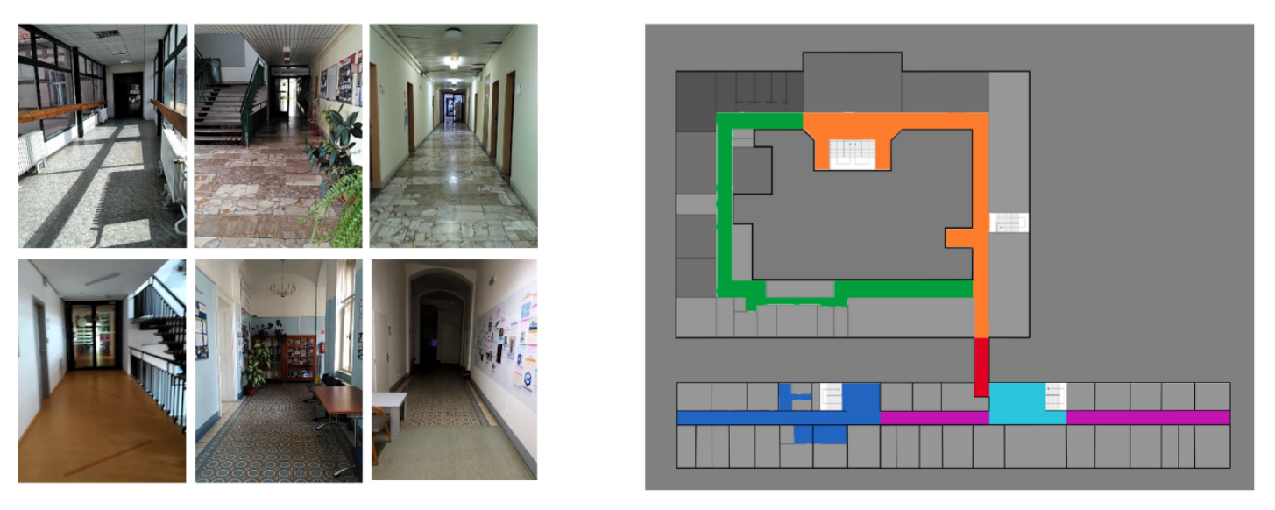
L. Hajduková: Camera-based indoor localization accuracy improvement (2021)

Slide 4
Next steps
Data collection
Anonymization
diverse data from video recordings
different recording angles, lighting conditions and the presence of people
wide-angle lenses
security
different methods and techniques
Initial classification model
Segmentation
segmentation of the building
max. 5 classes
the building division into segments
cross-segment boundary solution

Slide 5
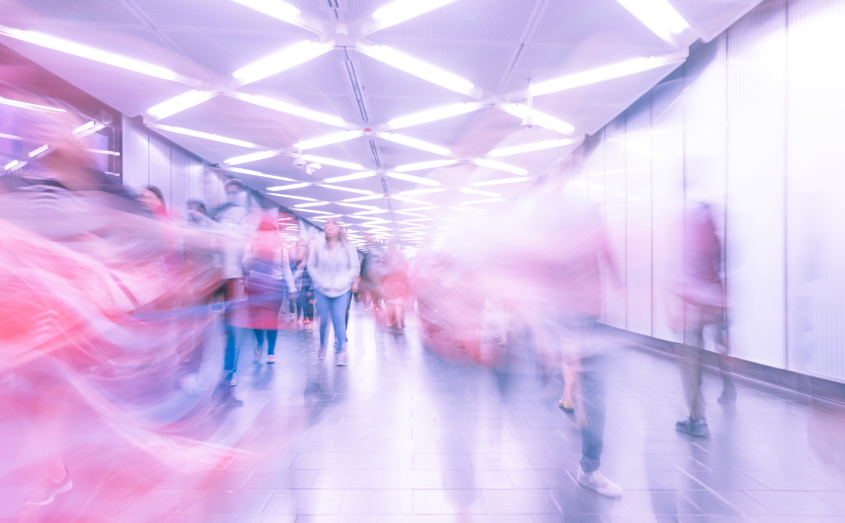
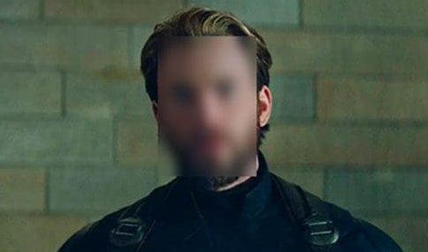
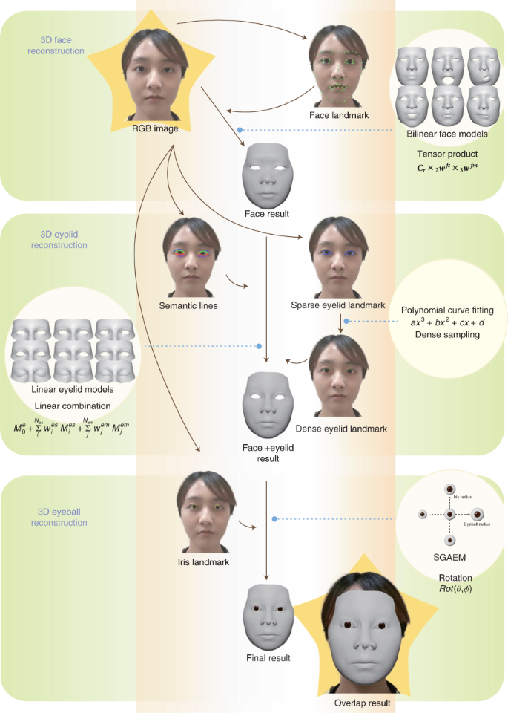
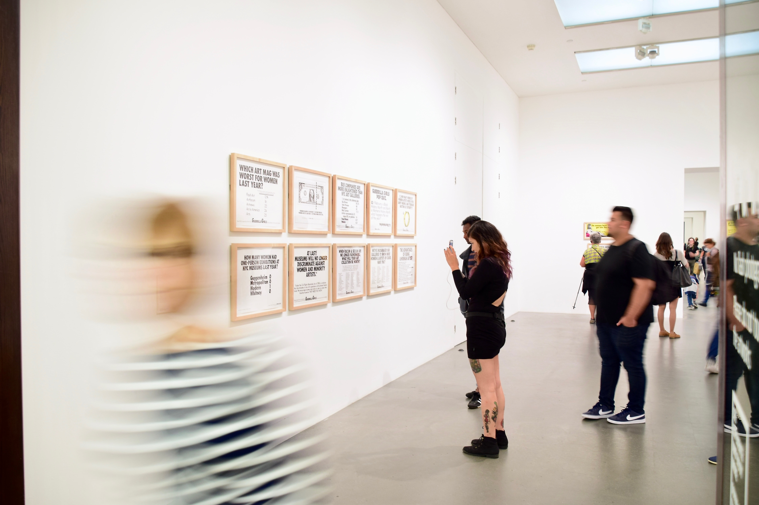
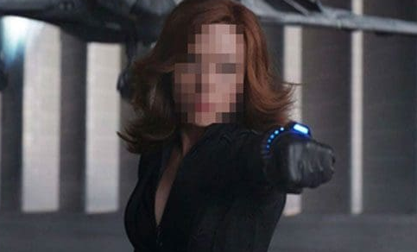
Anonymization
Computer vision techniques
face detection (object detection)
blur, censor, pixelation
long exposure photography simulation

Slide 6
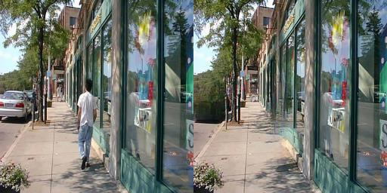
Anonymization
Automated object removal inpainter
ML
semantic segmentation and EdgeConnect architectures

Slide 7
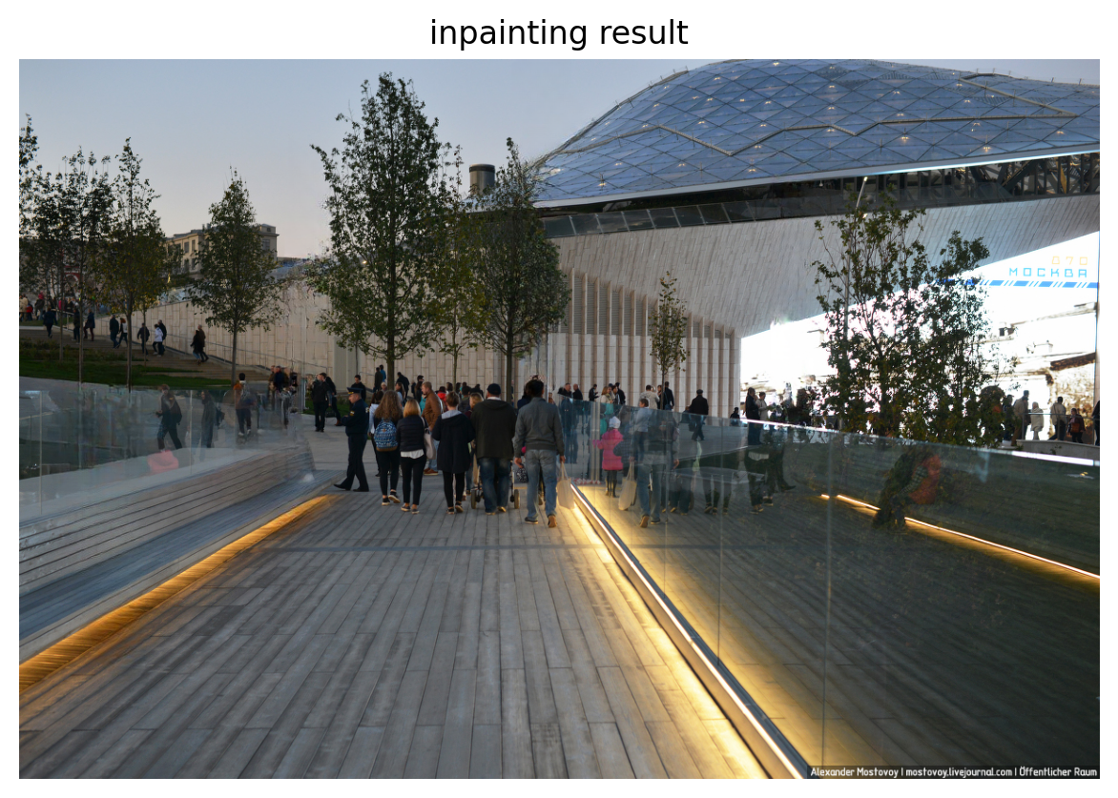
Anonymization
LaMa
Resolution-robust Large Mask Inpainting with Fourier Convolutions

Slide 8
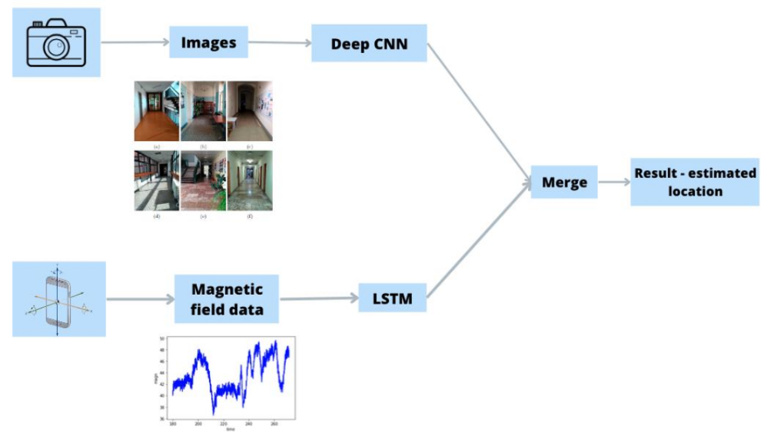
Further steps
Neural Networks
CNN classification model
Regression model
.
.
.
merge 2 NN model
*potential inclusion of AR

Slide 9
Thanks !

